Slide 1
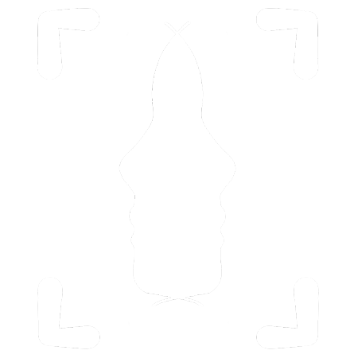
Mobile Apps to Reduce Cross-Race Recognition Deficit
Alvaro Santillan
Guangshi Xu
Liyang Ru
Madison Rivas
Siyu Yao
Logo for CU Psychology by Siyu Yao

Slide 2
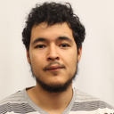
Team Introduction
Al Santillan
Role: Mobile Apps, iOS & Android
Interests: Mobile App Development, UI/UX, Front-End Development, Bots, & Ai.

Slide 3
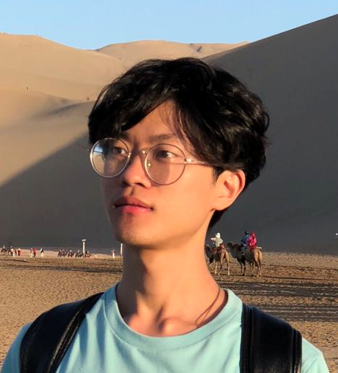
Team Introduction
Guangshi Xu
Role: Algorithm design, Back-End Development, Datasets generation.
Interests: Machine learning/AI, Robotics, UI/UX.

Slide 4
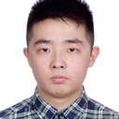
Team Introduction
Liyang Ru
Role: Back-End development, Algorithm design, Database Integration
Interests: AI development, Robotics, Machine Learning

Slide 5
Team Introduction
Madi Rivas
Role: Front-End development, Database Integration
Interests: Mobile App. Development

Slide 6
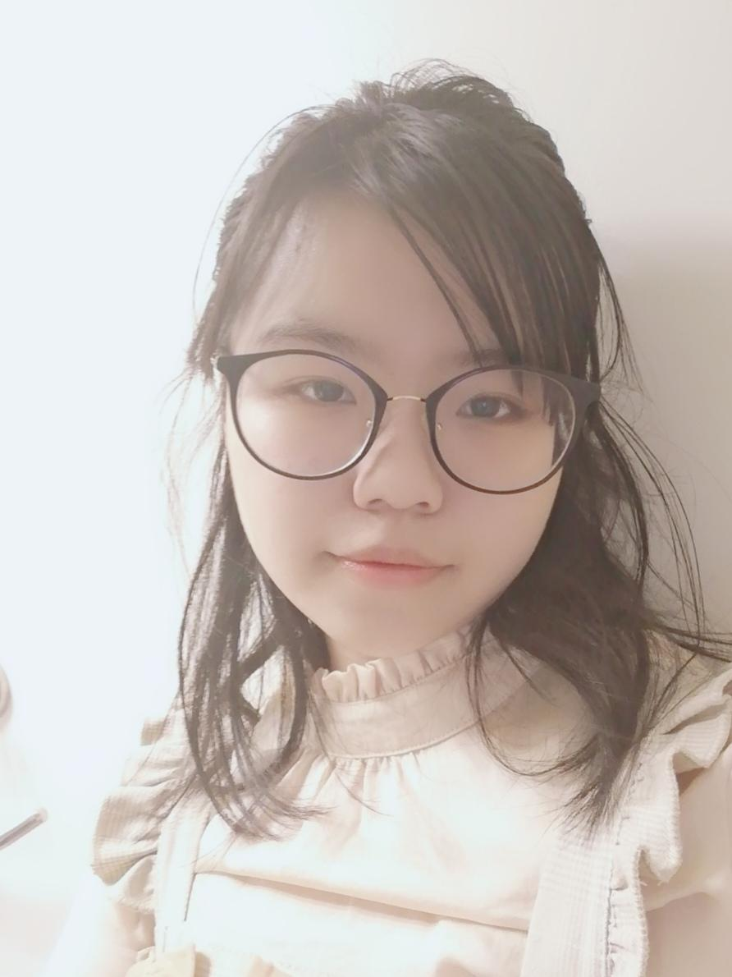
Team Introduction
Siyu Yao
UI designing
front end coding
Interested in AI/Machine learning
Part of the project management

Slide 7
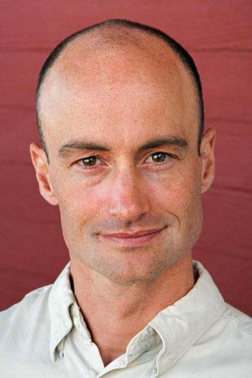
Joshua Correll
University of Colorado Boulder
Department of Psychology & Neuroscience
Joshua Correll (Ph.D.) is a social psychologist and associate professor here at CU Boulder.
Research focuses primarily on how we react to members of racial and ethnic outgroups.
particularly interested in the tendency to associate such outgroups with threat, and in the ways that this association affects attention, face processing and behavior.

Slide 8

University of Colorado Boulder
Department of Psychology & Neuroscience
CU Mission: To shape tomorrow’s leaders and be the top University for innovation, and to positively impact humanity.
Department Mission: To promote scholarship at the intersection of psychology and neuroscience. Driving this mission is a deep, shared commitment to improving the human condition for all people.
CU is a for profit university in Colorado. The research we are doing is not for profit.

Slide 9
Project Overview

Slide 10
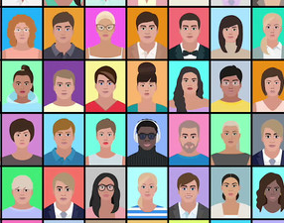
Brief Introduction
CRD: deficit between the accuracy of identifying faces within our own racial group in comparison to those in other racial groups is referred to as the cross-race deficit (CRD)
Help users reduce their CRD
Aid researchers by providing data surrounding CRD
Notes:
For some background, research suggests that although we are accurate at identifying faces within our own racial group, it can be much more difficult to identify the faces of those in different racial groups.
This deficit between the accuracy of identifying faces within our own racial group in comparison to those in other racial groups is referred to as the cross-race deficit (or CRD).
This project focuses on two goals: to help users reduce their CRD, and to aid researchers by providing user data surrounding CRD

Slide 11
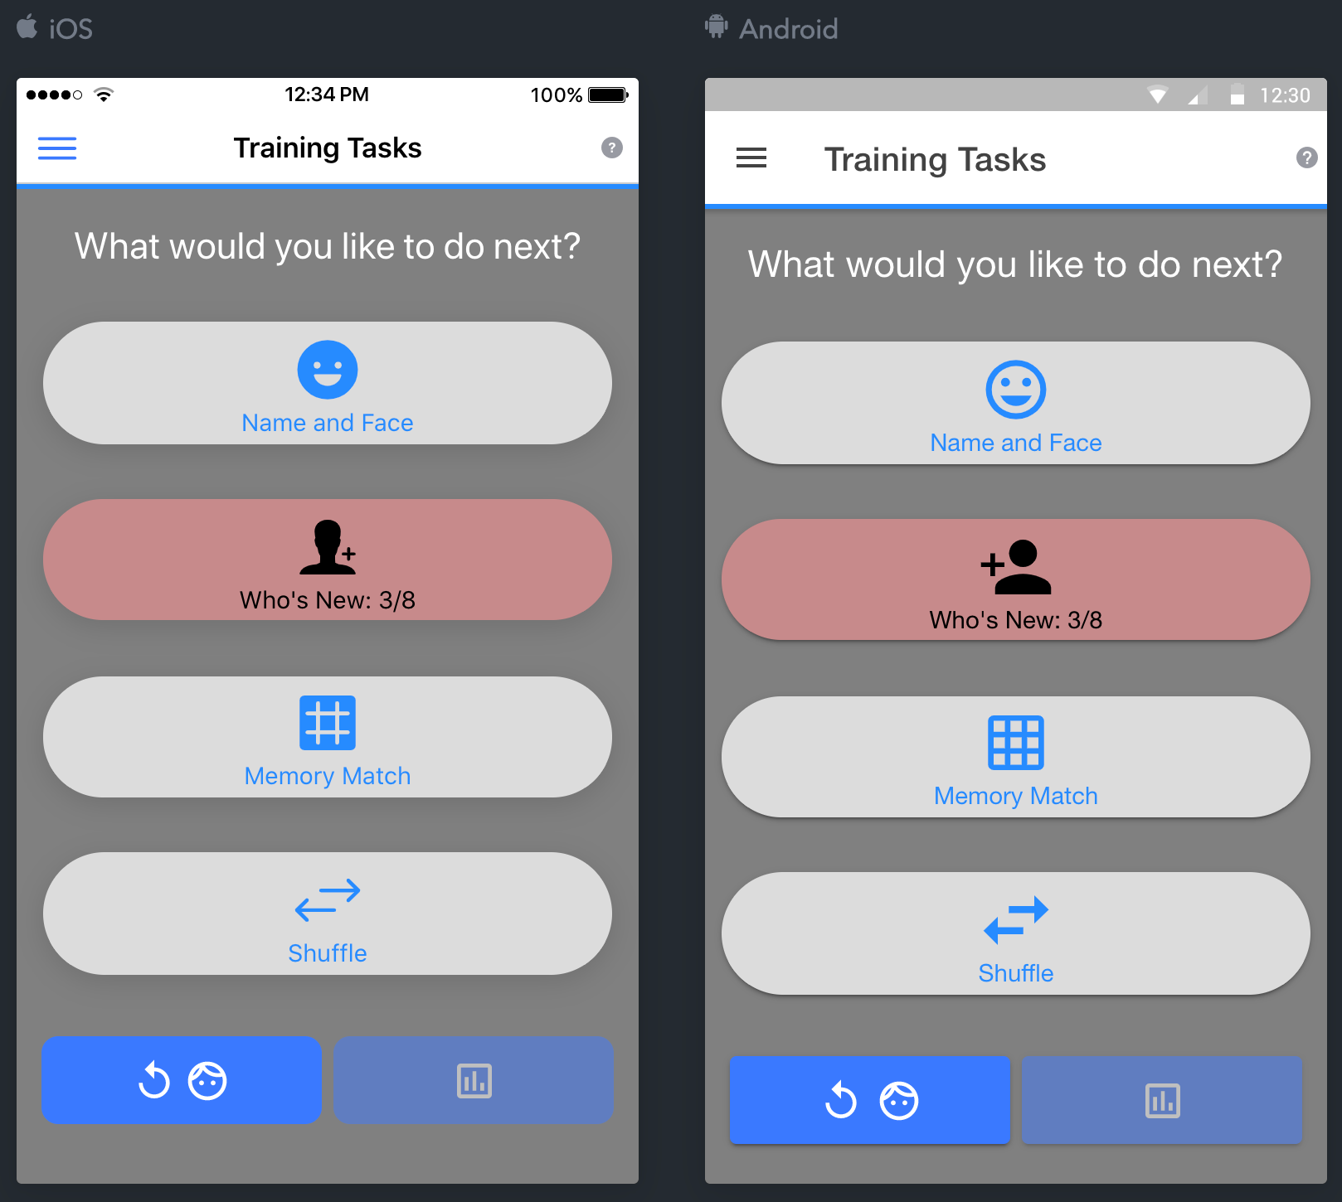
Business Problems
Current Trainings:
Matching name and face
Who’s new
“Memory”
Shuffle
New Training:
“Forced choice”, a daily assessment. It’s done at the beginning and the end every day.
Notes:
We are focused on publishing an iOS app and an android app that allows users to complete various exercises to reduce their CRD. Currently, the app has 4 main exercises: matching name and face, who’s new, “memory”, and shuffle. We will be adding an additional exercise called “forced choice” which is a daily assessment that will be completed at the beginning and end of each day. This exercise will be used to evaluate and analyze the participant’s performance

Slide 12
High-level Requirements
A mobile app to train users and reduce their CRD. The tasks are bundled into lessons to increase user engagement.
Researcher portal: User progress is recorded and made available to the CU Boulder Psychology Department for review in a research setting.
A method to store the data gained from app-usage on a server in the Psychology department.
Expand the racial and gender group

Slide 13
High-level Scope
An iPhone and Android app that includes the aforementioned tasks, bundled into short lessons of progressing difficulties. These lessons will contain hand-curated faces, as opposed to randomly selected ones. Each lesson should be short enough for the user to complete in a sitting.
Dynamic Difficulty: present users with different facial sets based on performance, this is done manually.
The gamification of each of the tasks, so as to maximize user engagement.
Application software maintenance and support.

Slide 14
Overall Approach
Learn how the previous team built their app and get a handle on the codebase.
Each project component will be built upon/developed and implemented separately.
After the needed components are developed, they will be integrated into the overall app.
Documentation will be created during development.
Preferred implementation for each application feature will be developed and implemented after approval from our Project Sponsor.

Slide 15







Tools & Methodology
Android Studios & Xcode for mobile app development.
Git and GitHub for version control.
Google Docs and Slides for documentation, presentations, and paperwork.
Heroku for database hosting.
VS Code for coding collaboration.
Figma for Prototype building.
Agile based development

Slide 16


Meeting & Communication Plan
Meeting Plan
Team Meetings are Sundays 7-8/9 pm MST
TA Meetings are Tuesdays 6-7pm MST
Sponsor Meetings are Mondays 3-4/5 pm MST
Communication Plan
Discord, for general communication.
Zoom, for group meetings.
Email, for communication with our TA, Instructor, & Sponsor.

Slide 17
Risks & Challenges
Limited communication
Continuous communication between the project team and project sponsor is needed
Different time zones.
Potential codebase be designed

Slide 18
Risks Mitigation
During this project, as issues arise that put the success of the project at risk, the issues and risks will be documented in the weekly status reports and tracked through resolution.
Any changes to the scope will require a discussion between the project team, project sponsor, and project mentor, and will require the approval of all parties to be accepted. These decisions will be made based on their impacts to the schedule and resources required.
Changes to scope will be recorded in the project charter as well as in the weekly status report.

Slide 19
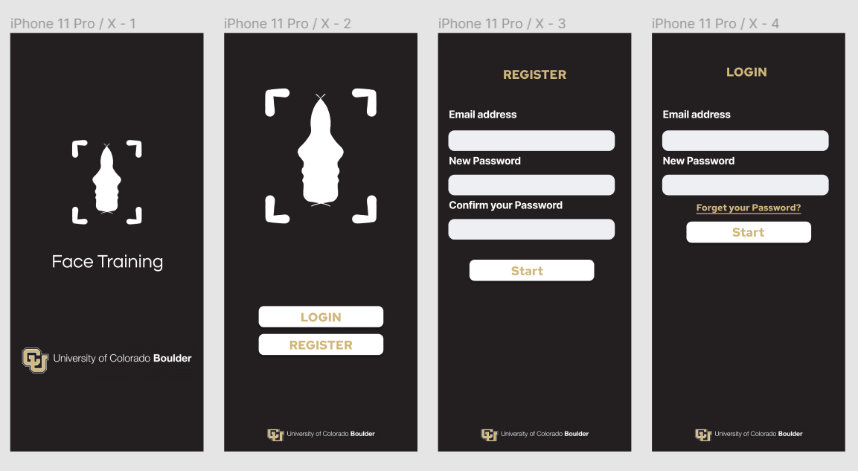
Current Status
We have redesigned a new Front End.
We are understanding the existing code base.
We have a database up and are looking for ways to improve.
We are in communication with the previous team.
We have two apps running (need work).

Slide 20
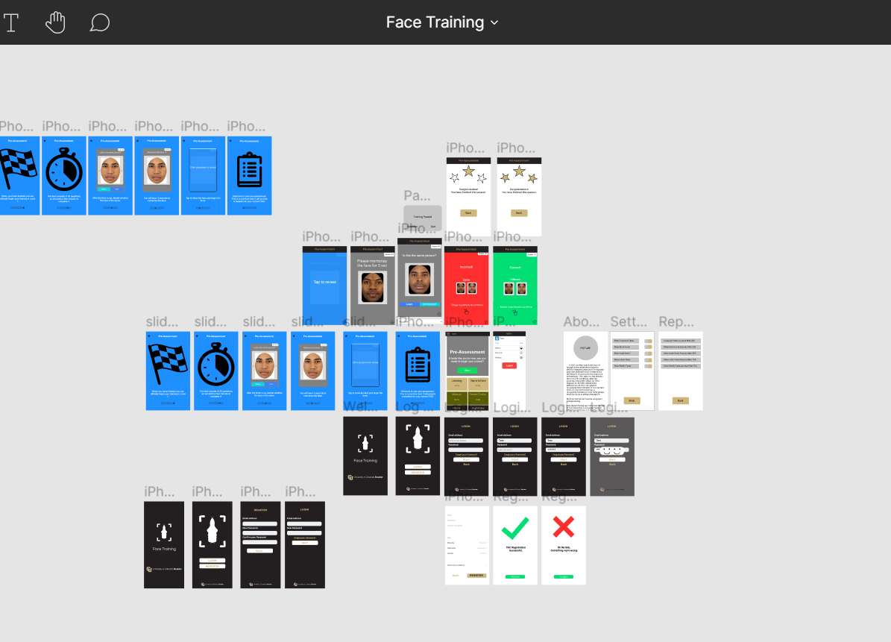
Project preview
https://www.figma.com/file/O5RlwLZ7LbwvT5n1jOVD8N/Face-Training?node-id=0%3A1

Slide 21
Thank You

Slide 22
Image Credits
https://imgur.com/gallery/btgYslb
https://ewn.co.za/2020/04/16/public-sharing-of-zoom-invites-makes-meetings-vulnerable-to-cyberattacks-analyst
https://github.com/logos
https://www.quora.com/Where-can-I-get-the-source-code-of-Android-Studio
https://comparecamp.com/xcode-ide-review-pricing-pros-cons-features/xcode-logo/
https://seekvectorlogo.net/heroku-vector-logo-svg/
https://publicmediastack.com/workflow-stage/collaboration-editing/figma/
https://www.seguetech.com/common-problems-experienced-when-adopting-agile-development/
https://www.colorado.edu/psych-neuro/josh-correll

